Slide 1
Tips for Presenters
Slides 1 and 2 are intended to help prepare you as the presenter
(please remove this slide before sharing/presenting).
Here are a few things to consider before presenting:
This presentation is intended to be an introduction to suicide prevention. It is not intended to train individuals in counseling, or any therapeutic modalities. Instead, it is intended to help raise awareness about the basic principles in suicide prevention.
Talking points have been added to each slide to provide you some guidance in your presentation. You are encouraged to “make the language your own” in-line with safe and effective messaging principles.
  We encourage presenters to review the recorded webinar “Principles for Effective Messaging for Suicide Prevention” prior to presenting: https://attendee.gotowebinar.com/recording/6994673372009747201
K n o w t h e S i g n s >> F i n d t h e W o r d s >> R e a c h O u t >> www.SuicideIsPreventable.org

Slide 2
Tips for Presenters
Slides 1 and 2 are intended to help prepare you as the presenter
(please remove this slide before sharing/presenting).
Here are a few things to consider before presenting:
Throughout the presentation certain general resources are listed that are available through Each Mind Matters and Know the Signs.
  When presenting to specific groups, we encourage you to take advantage of the resources for diverse communities available at EMMResourceCenter.org.
  If you need help locating a specific resource, or resources for a specific population, please contact us at info@suicideispreventable.org
The slides also include some media pieces including short films and PSAs available from Each Mind Matters. You can find additional media options at:
    EMMResourceCenter.org
    www.EachMindMatters.org
Additional suicide prevention films created by youth for youth from across California in many different languages can be found www.DirectingChangeCA.org/films
Short (28 second) word animated videos in English and Spanish with music to play as an introduction to your presentation: https://emmresourcecenter.org/resources/suicide-prevention-social-media-posts-and-animations
K n o w t h e S i g n s >> F i n d t h e W o r d s >> R e a c h O u t >> www.SuicideIsPreventable.org

Slide 3


Suicide Prevention 101
Tools You Can Use
Presenter Info
(Include your name and affiliation)
Insert Your Logo Here!
K n o w t h e S i g n s >> F i n d t h e W o r d s >> R e a c h O u t >> www.SuicideIsPreventable.org
Notes:
Speaker’s Note: Introduce yourself and your affiliation
In this presentation we will talk about suicide, but even more importantly about suicide prevention.
We cannot always prevent or remove suffering and pain, but we can cultivate hope and support resiliency by learning more about suicide and how to help and those we care about to find their reasons for living.
We will learn about clues and behaviors, known as warning signs that might indicate someone is thinking about suicide, what you can do if you are concerned about someone such as how to start an open and direct conversation with them about suicide prevention, and what you can do if you are concerned about someone.
We will get to know the resources that are available where you can learn more about suicide prevention and to get help, for yourself or someone else.

Slide 4

Test Your Suicide Prevention Knowledge
What are the three critical warning signs of suicide?
True or false: You should never ask someone if they are thinking about suicide.
What are three ways to help someone who is having thoughts of suicide?
Name at least two suicide prevention resources that are available 24/7.
K n o w t h e S i g n s >> F i n d t h e W o r d s >> R e a c h O u t >> www.SuicideIsPreventable.org
Notes:
Most of us will be impacted by suicide at some point in our lives.
Yet how much do we really know about suicide, and more importantly, how to prevent it?
Here are 4 questions to ask yourself as we begin. Don’t worry if you aren’t sure, or whether your answers are correct. You will see these questions again at the end of the presentation. By then, you will be able to answer them easily.

Slide 5
Is suicide preventable?
How do I know someone might be suicidal?
What can I do to help if I am concerned about someone?
What resources are available to support someone in crisis?
How do I cope with loss after suicide?
K n o w t h e S i g n s >> F i n d t h e W o r d s >> R e a c h O u t >> www.SuicideIsPreventable.org
Notes:
Here on screen you see some of questions many people have about suicide prevention. This presentation will address these questions and hopefully others you may have or be asked.

Slide 6
Words Matter
Use | Don’t Use
“died by Suicide” or “took their own life” | “committed suicide” Note: Use of the word commit can imply crime/sin
“attempted suicide” | “successful” or “unsuccessful” Note: There is no success, or lack of success, when dealing with suicide
Source: https://www.ncbi.nlm.nih.gov/pmc/articles/PMC6563960/
K n o w t h e S i g n s >> F i n d t h e W o r d s >> R e a c h O u t >> www.SuicideIsPreventable.org
Notes:
Before we get started, I would like to clarify some of the recommended terminology around suicide prevention.
When it comes to suicide prevention, the terms, phrases and words we use can have a significant impact on the way messages are received. Messages can either encourage someone to seek help and reach out, or they can push people further from the support they need. The suicide prevention community is trying to clarify the ways we all refer to actions related to suicide to better support help-seeking behavior among those that who are at risk.
The most common phrase we use when someone has died by suicide is “committed suicide”. It is recommended to avoid this term because it is ,most often associated with criminal actions. Framing suicide this way can bring about feelings of shame, guilt or stigma that can be hurtful to loss survivors or inadvertently reinforce a negative bias preventing people from reaching out for help.
You may have heard people refer to a “successful” or an “unsuccessful” suicide attempt. But there is no success or lack thereof when talking about suicide.
These actions should be referred to clearly as a death by suicide, or an attempted suicide. Using this phrasing helps to remove the negative bias of shame or stigma.
One recent study explored this terminology and found that among respondents, “took their own life”, “died by suicide” and “attempted suicide” received the highest consistent marks for acceptability.
Speaker’s Note: Option to share this reference if asked: Language use and suicide: An online cross-sectional survey https://www.ncbi.nlm.nih.gov/pmc/articles/PMC6563960/

Slide 7

What “causes” suicide?
The causes of suicide are complex.
Suicide is not caused by any one factor.
Most people who experience risk factors do not die by suicide.
K n o w t h e S i g n s >> F i n d t h e W o r d s >> R e a c h O u t >>
Notes:
In the desire to find answers, there is a danger of oversimplifying the causes of suicide.
What are some things that you have heard, or thought, causes suicide? (Option to let members of the audience share some responses; common ones may include military service, bullying, are common ones, but note that attribution to ANY single cause is oversimplifying)
Using these examples, we know that most people who experience these situations and conditions, do not die by suicide.
Attributing the cause of suicide to a single factor can also signal that a suicidal response to that factor is normal, which might discourage people from seeking help for themselves or someone else.
The causes of suicide are complex, and typically there are many different factors that contributed to suicide risk over time.

Slide 8

When Hope is Hard Work
Suicide is often surrounded by stigma, making it less likely someone will seek help, and harder to know when someone really needs help.
People who are suicidal do not want to die, as much as they do not want to go on living with their pain.
The more we understand about suicide prevention the more we can help the people we care about who are struggling.
K n o w t h e S i g n s >> F i n d t h e W o r d s >> R e a c h O u t >> www.SuicideIsPreventable.org
Notes:
Historically and even today, suicide carries a lot of stigma, prejudice, and fear.
People who are thinking about suicide may be hesitant or afraid to tell someone about their thoughts or reach out for help for fear of what others will think, worry about how it will affect their family and relationships, or even their employment. Some may doubt that anything can be done to help them “so why bother?”
Sometimes people thinking about suicide already feel like a burden to their loved ones, and don’t speak up out of worry of becoming even more of a burden.
It can help to understand that people who are having thoughts of suicide are experiencing intense emotional pain. Most of the time, they don’t want to die, but they cannot see a way out of the pain or able to continue living with the pain; not wanting to live is actually different than wanting to die.
We can reduce the stigma, fear and prejudice around suicide increasing our knowledge and educating others, trying to understand and respect the pain that someone who is having thoughts of suicide is experiencing, and feeling more confident to talk directly about suicide with someone we are concerned about.

Slide 9
Know the warning signs
What can
be done
to
prevent
suicide?
Ask directly: “Are you thinking about suicide?”
Make a safety plan and reduce access to lethal means
Connection to MH professional trained in suicide prevention treatments (DBT, CAMS, etc.)
Create systems to respond to suicide risk in least restrictive (least traumatizing) way
Notes:
There are steps we can all take to prevent suicide, from knowing the signs and how to help people we care about, to learning about what your community can do to prevent suicide.
On the personal level:
Know the warning signs of suicide
Be willing to ask someone you are concerned about directly if they are thinking about suicide
Learn the elements of a safety plan and how it can help you keep someone you are concerned about safe
Know the resources for support, from crisis lines to professional providers
On the community level:
Advocate for and support suicide prevention training for professional providers and creating a system of suicide prevention in your community
Let’s talk about these in more depth.

Slide 10
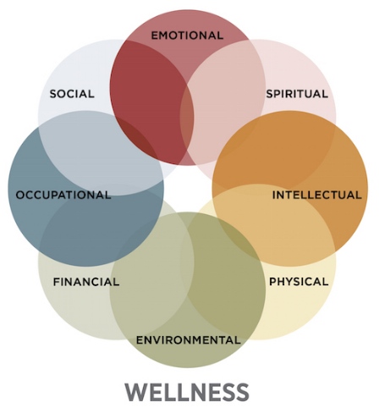
Warning Signs & Risk Factors
Warning signs: Specific behavioral or emotional clues that may indicate suicidal intent.
Risk factors: Conditions or circumstances that may elevate a person’s risk for suicide.
K n o w t h e S i g n s >> F i n d t h e W o r d s >> R e a c h O u t >> www.SuicideIsPreventable.org
Notes:
Knowing the warning signs of suicide is one of the most important first steps in prevention. It’s also important to know the difference between warning signs and risk factors.
Warning Signs
A suicide warning sign is the earliest detectable sign that indicates a person is at heightened risk for suicide in the near-term (i.e., within minutes, hours, or days). These are observable clues and behaviors
relate to an individual’s immediate state. Similar to the warning signs of a heart attack – such as chest discomfort or shortness of breath – the warning signs of suicide signal the potential for immediate or short-term crisis. Also similarly, it is a cluster of these signs that most strongly signal risk rather than only one or two warning signs.
Risk Factors
Suicidal behavior is complex and is not caused by a single risk factor or life event. Risk factors tend to be longer term than warning signs, and are not in and of themselves an indication of immediate suicide risk.
Whereas warning signs always refer to an individual’s current state, risk factors are often based on population level data.
To continue the analogy, risk factors of a heart attack might include older age, family history of heart disease, and lifestyle factors.
Keep in mind that every individual and situation is different. What impacts one person profoundly might not have the same effect in another due to a wide variety of factors. Because someone has risk factors does not mean that they are or will become suicidal.

Slide 11
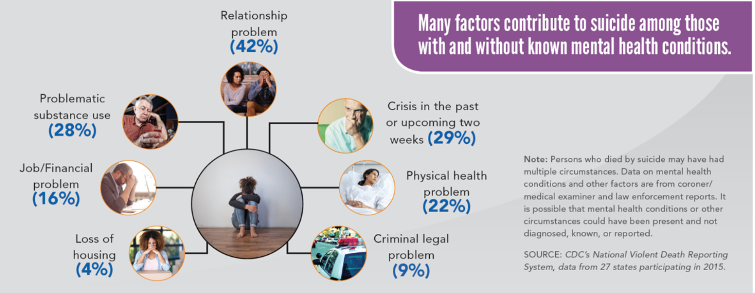
Risk Factors for Suicide
https://www.cdc.gov/violenceprevention/datasources/nvdrs/index.html
K n o w t h e S i g n s >> F i n d t h e W o r d s >> R e a c h O u t >> www.SuicideIsPreventable.org
Notes:
Whereas mental health conditions are often seen as the cause of suicide, suicide is rarely caused by any single factor.
In 2018 the CDC released a report that examined some of the factors that can contribute to suicide risk. The report found that many people who die by suicide are not known to have a diagnosed mental health condition at the time of death. Other problems often contribute to suicide, such as those related to relationships, substance use, physical health, and job, money, legal, or housing stress.

Slide 12
What Groups are Most Impacted by Suicide?
Statistically, the following population groups are disproportionately affected by suicide risk:
Males
American Indian/Alaska Natives and Whites
Older adults
Veterans
Those living in rural areas
LGBTQ youths and adults
K n o w t h e S i g n s >> F i n d t h e W o r d s >> R e a c h O u t >> www.SuicideIsPreventable.org
Notes:
While suicide can impact anyone, certain populations are disproportionately impacted by suicide, meaning rates of suicide in these groups are higher compared with other groups.
The populations that are disproportionately impacted by suicide include:
Males compared with females (although females attempt suicide at higher rates)
By race/ethnicity, American Indian/Alaska Natives and Whites
Older adults compared with younger people; however in recent years rates among middle aged adults, particularly males, are on the rise
Veterans compared with non-veterans;
Those living in rural areas compared with those living in urban areas.
LGBTQ adults and youth compared with heterosexual adults and youth.

Slide 13
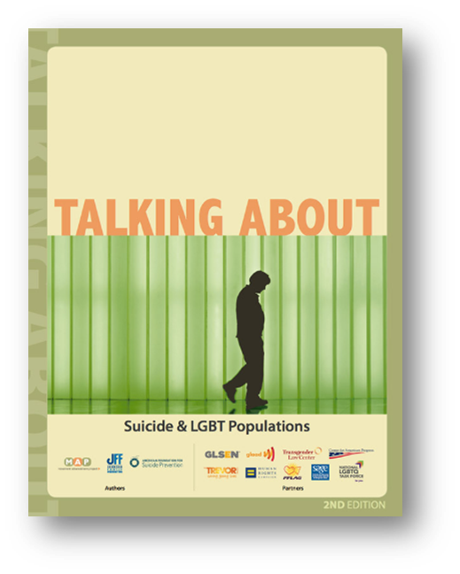
“Suicidal behaviors in LGBT populations appear to be related to “minority stress”, which stems from the cultural and social prejudice attached to minority sexual orientation and gender identity. This stress includes individual experiences of prejudice or discrimination, such as family rejection, harassment, bullying, violence, and victimization. These negative outcomes, rather than minority sexual orientation or gender identity per se, appear to be the key risk factors for LGBT suicidal ideation and behavior.”
https://www.lgbtmap.org/file/talking-about-suicide-and-lgbt-populations-2nd-edition.pdf
Notes:
It is important to be mindful of the words we use when we are talking about groups that are disproportionately impacted by suicide.
When we make statements such as “LGBT youth are x times more likely to die by suicide” or “22 Veterans die by suicide every day”, we inadvertently send a potentially harmful message.
Just because someone is a Veteran or identifies as LGBT does not make them more likely to die by suicide; rather it is risk factors associated with their profession or gender or sexual identity.

Slide 14
Protective Factors
Access to effective behavioral health care
Connectedness to individuals, family, community, and social institutions
Life skills, including problem solving skills and coping skills, ability to adapt to change
Self-esteem and a sense of purpose or meaning in life
Cultural, religious, or personal beliefs that discourage suicide
K n o w t h e S i g n s >> F i n d t h e W o r d s >> R e a c h O u t >> www.SuicideIsPreventable.org
Notes:
Although much of the attention in suicide prevention is paid to warning signs and risk factors for suicide, it is equally or even more important to consider the strength of protective factors against suicide.
Protective factors are personal or environmental characteristics that help protect people from suicide.
In theory, a person with strong protective factors would have greater coping skills to deal with higher levels of stressors than someone without supports, therefore reducing suicide risk. Even someone with very strong protective factors can become overwhelmed and potentially suicidal, but protective factors can create greater resiliency during tough times.
On the slide, you see a few examples of protective factors, including:
Access to effective behavioral health care
Connectedness to individuals, family, community, and social institutions
Life skills, including problem solving skills and coping skills, ability to adapt to change
Self-esteem and a sense of purpose or meaning in life
Cultural, religious, or personal beliefs that discourage suicide
Speaker’s Note: OPTIONAL activity - Ask the attendees to list any additional protective factors

Slide 15
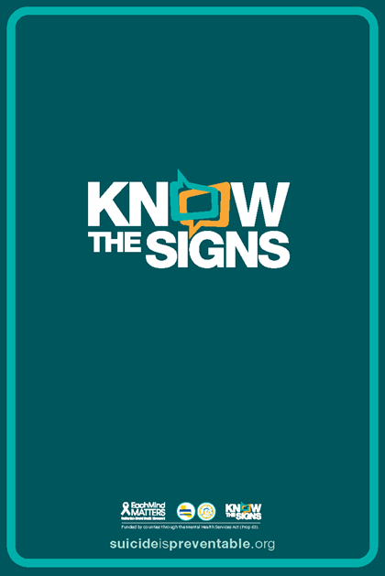
Critical Warning Signs
If any of these critical warning signs are present, call the Suicide Prevention Lifeline at 1-800-273-8255 right away:
Threatening to hurt or kill oneself, or talking of wanting to hurt or kill oneself
Making plans for suicide, or looking for ways to kill oneself (purchasing a gun, stockpiling pills, etc.)
Talking, posting or writing about death, dying, or suicide, when these actions are out of the ordinary for the person
K n o w t h e S i g n s >> F i n d t h e W o r d s >> R e a c h O u t >> www.SuicideIsPreventable.org
Notes:
Pain isn’t always obvious, but most people who attempt suicide give some indication of their thoughts and feelings prior to taking action.
These warning signs may be behaviors, words, social media posts, or attitude changes. Learning to recognize these signs and how to respond appropriately are actions that you can take that may help save a life.
The critical warning signs of suicide are cause for concern, and should be taken seriously. These include:
Threatening to hurt or kills oneself, or talking of wanting to hurt or kill oneself
Looking for ways to kill oneself, such as purchasing a gun, stockpiling pills, or researching suicide methods online
Talking or writing about death, dying or suicide when these actions are out of the ordinary for the person
Warning signs of suicide are especially concerning when the behavior is new, has increased, or seems related to a painful even, loss, or change. Examples might include the loss of a job, spouse or loved one.

Slide 16

What are
some other warning signs
for suicide?
Notes:
Speaker’s Note: Ask the audience to suggest additional warnings beyond what was mentioned on previous slide (critical warning signs)

Slide 17
Feeling hopeless or worthless
Extreme mood swings
Feeling trapped or in unbearable pain
Withdrawal, isolation
Fear of becoming a burden
Sudden uplift in mood, without a reason
Sleeping too much or too little
Preoccupation with death or a lack of concern about personal safety
Increasing use of substances, especially alcohol
These additional warning signs may not indicate an immediate crisis, but are also cause for concern, especially when the behavior is new, has increased, or seems related to a painful event , loss or change.
Notes:
These additional warning signs may not indicate an immediate crisis, but are also cause for concern, especially when the behavior is new, has increased, or seems related to a painful event , loss or change.
Feeling hopeless and/ or worthless; fear of becoming a burden.
A preoccupation with death or a lack of concern about personal safety; recklessness.
Feeling trapped, a sense of downward spiral and no way out
Increasing use of substances, especially alcohol.
Anger, irritability, resentment, seeking revenge. Often we think of someone who is having thoughts of suicide as always being sad or depressed, however anger and aggressions is how some people express their pain.
Changes in sleep
Withdrawal, isolation
Sudden uplift in mood, without a reason, could signal they have created a “plan” (which often includes a sense of relief or improved mood for the individual). This warning sign should be taken very seriously as it might demonstrate the individual is at an increased risk of suicide.
The most important thing is to trust your instincts: you know your friends and loved ones best. If you feel like something is off or notice some of these changes, then you need to have a conversation with them and ask directly about suicide.

Slide 18
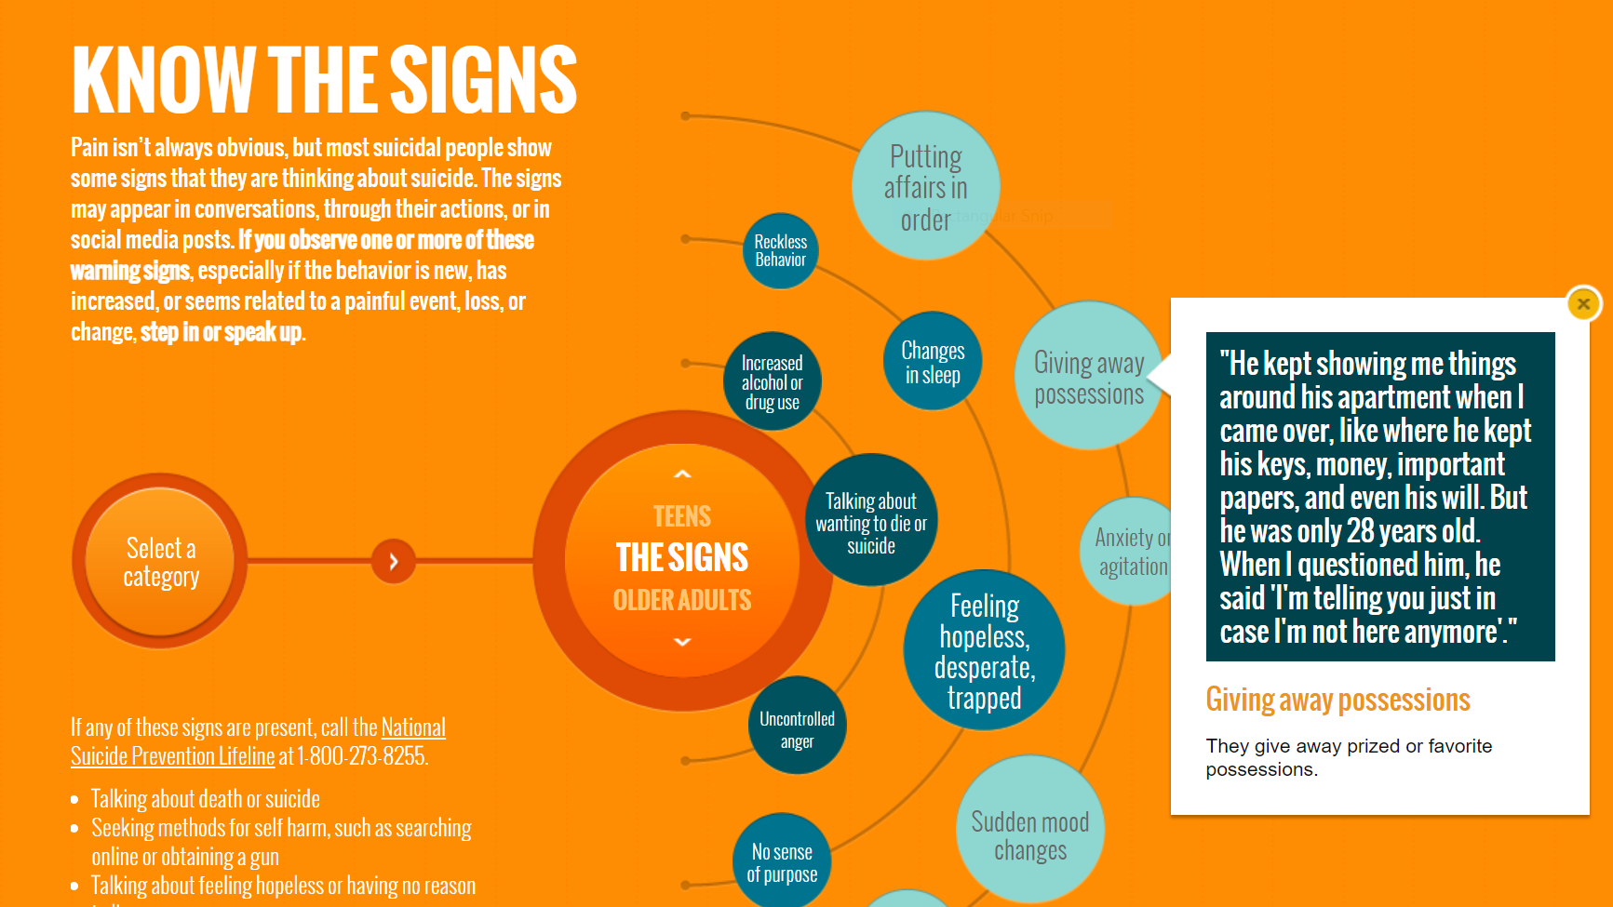
Notes:
Speaker’s Note: As time permits, spend time live on the Know the Signs website and click on different warning signs. When you click on the Know the Signs portion of the site, you can find warning signs for the general public, teens and older adults. When you click on a sign, more information will pop up as seen in the slide included here.

Slide 19

What You Can Do
If you sense something is wrong, don’t delay in getting help!
Find the Words to have this difficult conversation.
Express your concern, mention specific things you have noticed
Ask directly if they are thinking about suicide
K n o w t h e S i g n s >> F i n d t h e W o r d s >> R e a c h O u t >> www.SuicideIsPreventable.org
Notes:
If you sense something is wrong, don’t delay in getting help.
The first step is to find the words to have a conversation with someone you are concerned about.
During the conversation, express your concern and mention specific things you have noticed that have caused your concern.
Ask them directly if they are thinking about suicide. (NEXT SLIDE)

Slide 20
Starting the Conversation
Dad, I’ve noticed some changes in you recently that are worrying me. You used to spend time at the barbershop with your buddies but you haven’t had a haircut in a long time. Lately it seems like you aren’t enjoying all the things you used to like doing.
Joe, it’s not like you to avoid your friends. And I heard you say something earlier today about not being around to see how the next football season goes.
Honey, I’m worried about you. You just don’t seem yourself lately. I think your appetite is off and it looks like you’re losing weight.
K n o w t h e S i g n s >> F i n d t h e W o r d s >> R e a c h O u t >> www.SuicideIsPreventable.org
Notes:
Starting the conversation may seem intimidating, but it’s important to remember that usually when someone is having thoughts of suicide, they are looking for an opportunity to talk about it.
Remember, you aren’t expected to have all of the answers, you are simply trying to create the space to have an open conversation about suicide. Start by expressing your concern and mention specific things that you have noticed. Let them know you care about them, and you want to help.
These are some examples of how you can start the conversation.
“Dad, I’ve noticed some changes in you recently that are worrying me. You used to spend time at the barber shop with your buddies but you haven’t had a haircut in a long time. Lately it seems like you aren’t enjoying the things you used to like doing.”
“Joe, it’s not like you to avoid your friends. And I heard you say something earlier today about not being around to see how the next football season goes.”
“Honey, I’m worried about you. You just don’t seem yourself lately. I think your appetite is off and it looks like you’re losing weight.”

Slide 21
It’s OK to be Direct
Are you thinking
about
suicide?
Talking about suicide does not increase suicidal behavior.
By talking openly and directly, you are sending the message that you care and want to help.
K n o w t h e S i g n s >> F i n d t h e W o r d s >> R e a c h O u t >> www.SuicideIsPreventable.org
Notes:
The next step is to ask them directly if they are thinking about suicide.
It can be difficult to do this because we might be afraid of putting the idea in the person’s head, or that bringing suicide up will cause it to happen. In fact, the opposite is true: talking openly and directly about suicide is the first step in preventing it. Often people who are having thoughts of suicide isolate and don’t share their thoughts for a variety of reasons; they may feel like they would be burdening their friends and loved ones or may not believe anyone can or wants to help.
Asking directly about suicide invites the person to talk openly about their thoughts, let’s them know you are there to support and help, and conveys that you aren’t scared to talk about suicide.
These conversations often “release a pressure valve” that begin the process for reducing risk by making suicide an issue that we are going to address together.

Slide 22
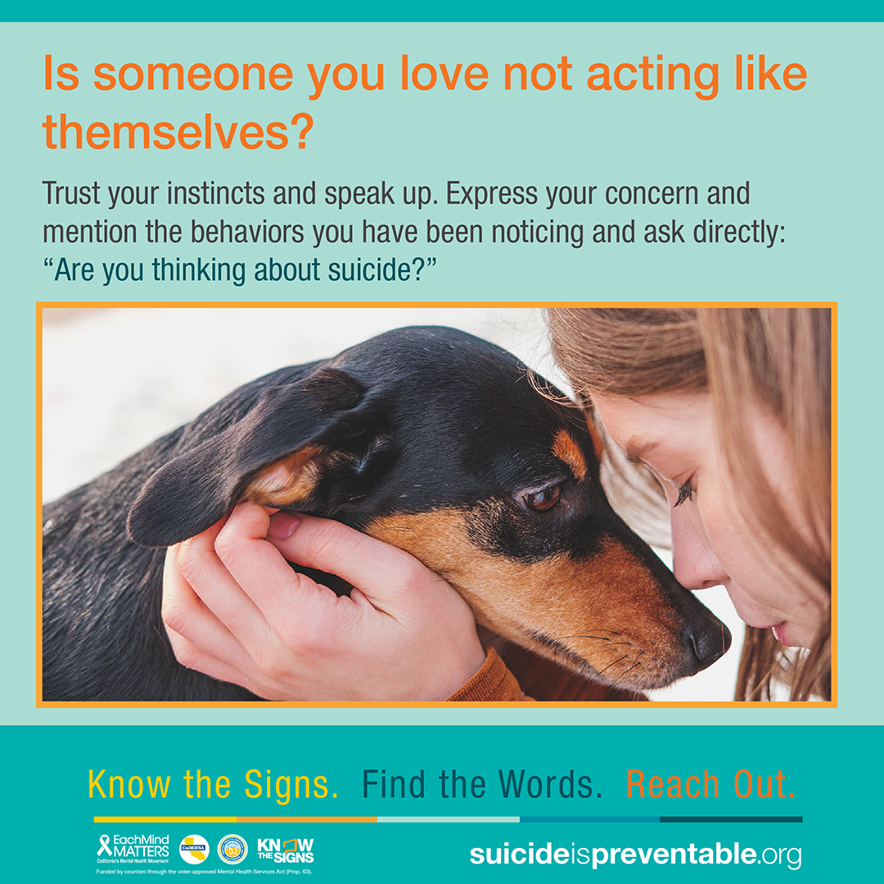
Are you thinking about suicide?
Have you thought about how you would do it? (have you made a plan?)
When do you feel the most pain? What happens before that leads to you thinking about suicide?
What have you done in the past to stop you from making an attempt?
K n o w t h e S i g n s >> F i n d t h e W o r d s >> R e a c h O u t >> www.SuicideIsPreventable.org
Notes:
These are some ways to talk directly about suicide:
“Are you thinking about suicide?”
NOTE: it’s important to be direct and AVOID asking “are you thinking about hurting yourself?”. Asking the question in that way may miscommunicate to the individual that you are asking about suicide. Some people don’t see suicide as “hurting themselves” as they may think it will release their pain (which is not true), or that may think you are referring to self harm. It’s important to be direct
“Have you thought about how you would do it? Have you made a plan?”
NOTE: Determining whether someone has developed a plan is often a key component in determining their suicide risk level. Development of a plan is usually what distinguishes be low and moderate/high risk
“When do you feel the most pain? What happens before that leads you to thinking about suicide?”
NOTE: Understanding what drives the pain, and helping the individual explore this, can help you better empathize and may also help them begin to gain some control over their thoughts of suicide. “What have you done in the past to stop you from making an attempt?”
NOTE: This information is a key component of building a safety plan for the individual.

Slide 23
Tips for Effective Communication
Take a deep breath
Create a safe environment
Give yourself plenty of time (don’t rush)
Be prepared with resources and also for their response (yes or no)
Listen more than you talk
Make sure to have your own supports in place
You don’t have to have all the answers.
The most important thing you can do is listen.
K n o w t h e S i g n s >> F i n d t h e W o r d s >> R e a c h O u t >> www.SuicideIsPreventable.org
Notes:
To prepare for the conversation:
Take a deep breath
Create a safe and calm environment
Give yourself plenty of time so the conversation won’t feel rushed
Be prepared with resources to share with them, and how you will respond to the direct question of whether they are thinking about suicide, e.g. if they say “yes” or “no”
Listen more than you talk – you don’t need to have all the answers, the most important thing you can do is listen and be there for the person
Make sure you have your own supports in place to help you debrief and destress; self care is vital to being able to effectively care for others

Slide 24
Encourage them to talk about how they are feeling
Support their coping and resiliency. Ask what helps them feel better.
Encourage them to reach out to resources such as the Suicide Prevention Lifeline
Remind them that you are there for them
Listen without lecturing or judgment
Be vigilant about the behaviors you are noticing and continue to check in with them on a regular basis.
If They Say “No”
K n o w t h e S i g n s >> F i n d t h e W o r d s >> R e a c h O u t >> www.SuicideIsPreventable.org
Notes:
When you ask the person if they are thinking about suicide, they may say ”no”. Below are some tips for what to say and do if that happens.
Continue to encourage them to talk about how they are feeling
Support their coping and resiliency; ask them what helps them feel better
Encourage them to reach out to resources, such as the Suicide Prevention Lifeline, or other resources that can offer tools for coping and support
Remind them that you are there for them
Listen without lecturing or judgement
Be vigilant about the behaviors you are noticing, and continue to check in with them on a regular basis

Slide 25

Take it seriously
Remain calm
Thank them for their honesty and openness
Encourage them to talk about the reasons they feel this way and listen
The most important action you can take is to listen…really listen
Encourage them to reach out for help; offer to make the call with them
If They Say “YES”
K n o w t h e S i g n s >> F i n d t h e W o r d s >> R e a c h O u t >> www.SuicideIsPreventable.org
Notes:
If they say “yes”:
Take it seriously but remain calm
Remain calm, remember that just being present with them is helping to reduce their risk and keeping them safe
Thank them for their honesty and openness
Encourage them to talk about the reasons they feel this way, and listen; truly listening is the most important action you can take
Explore and see if you can help them identify some reasons for living
Encourage them to reach out for help, let them know you’ll support them, and offer to make the call with them

Slide 26
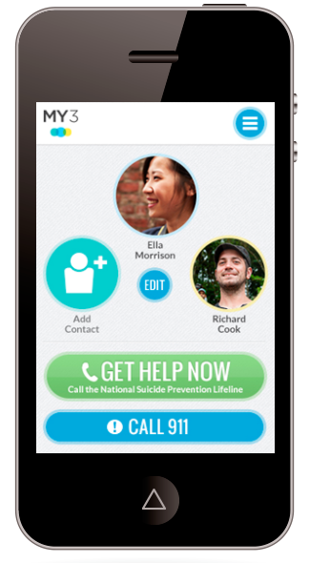
Plan for Safety
Prioritize safety: Ask them if they have access to weapons or medications, and work with them to safely store those items
Help them identify signs of crisis and things they can do to help take their mind off their problems.
Make a list of who they can call when they are in a crisis
  Trusted individuals, professionals, agencies such as a crisis line
www.MY3app.org
K n o w t h e S i g n s >> F i n d t h e W o r d s >> R e a c h O u t >> www.SuicideIsPreventable.org
Notes:
The next step is to plan for safety
Ask them if they have access to weapons or medications, and work with them to safely store those items
Help them identify signs of crisis and things they can do to help take their mind off their problems
Make s list of who they can call when they are in crisis – this can include trusted individuals, mental health professionals, or crisis lines
The slide shows MY3, a free app that helps users create a safety plan, in partnership with a mental health professional, counselor, or other provider

Slide 27
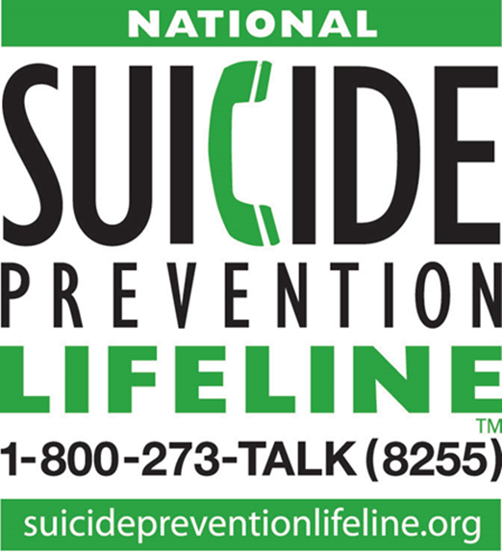
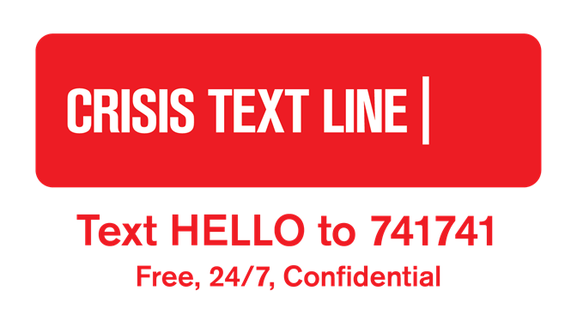
Reach Out
You are not alone. There are resources available 24/7 to help.
K n o w t h e S i g n s >> F i n d t h e W o r d s >> R e a c h O u t >> www.SuicideIsPreventable.org
Notes:
Having a list of resources available before you have the conversation is helpful, not only to share with the person you are concerned about but to support your confidence that you are not alone.
The resources on the slide are available 24/7 to support people who are in crisis, and are also available for you to contact for advice and to discuss your concerns about someone else.
The Lifeline is available 24/7 in English or Spanish. Calls are answered by trained counselors at the nearest crisis center. Lifeline also has online chat services and a prompt to be connected to counselors trained in working with veterans. The counselor who answers the call can help sort through your concerns and how to have a conversation with someone you’re concerned about.
The Lifeline can be reached by calling 1-800-273-8255, or through online chat at suicidepreventionlifeline.org.
Callers can also select a prompt to connect with counselors specifically trained to support military servicemembers, veterans, and their families/
24/7 Crisis services are also available through the Crisis Text Line by texting HELLO to 741741

Slide 28
If you have ever been in this position, you know how difficult it can be.
The fear of saying or doing the wrong thing, or not doing enough, can be overwhelming.
The safest response might seem like calling 911. While this is true in some situations, in most situations, a less drastic response may be more helpful.
Instinct and compassion: two tools you can always count on. There is no foolproof process for knowing exactly the right thing to do. Trust your instinct if it tells you something is wrong.
Should You Call 911?
K n o w t h e S i g n s >> F i n d t h e W o r d s >> R e a c h O u t >> www.SuicideIsPreventable.org
Notes:
If you have ever been seriously concerned that someone might be thinking of suicide,in this position, you know how difficult it can be. The fear of saying or doing the wrong thing, or not doing enough, can be overwhelming. The safest response might seem like calling 911. While this is true in some situations, in most situations, a less drastic response may be more helpful.
There is no foolproof process for knowing exactly the right thing to do. Trust your instinct if it tells you something is wrong. Leading with compassion can help create safe spaces for people to talk about their pain and this is one of the most helpful things you can do.

Slide 29
Calling 911 connects the situation to first responders, such as law enforcement, firefighters and EMT. If you suspect someone is about to or has already harmed themselves and requires medical attention, or if you are in danger, you should call 911.
Crisis lines are equipped to deal with crisis situations. Crisis line counselors quickly assess the level of risk get the caller to the appropriate services if risk is imminent. They also counsel the person over the phone to reduce their risk. Crisis lines can also be helpful if you are concerned about someone else.
When Should You Call 911?
Helpful Blog: https://www.eachmindmatters.org/covid19/supporting-someone-while-they-find-their-reasons-for-living/
K n o w t h e S i g n s >> F i n d t h e W o r d s >> R e a c h O u t >> www.SuicideIsPreventable.org
Notes:
If you feel the situation is beyond your abilities, or if you feel the attempt is imminent or an attempt has already occurred, then you should call 911.
Calling 911 connects the situation to first responders, such as law enforcement, firefighters and EMTs. If you suspect that someone is about to or has already harmed themselves and requires medical attention, or if you are in danger, this is the right tool.
Crisis lines, such as the National Suicide Prevention Lifeline, are answered by crisis counselors who are trained to quickly assess the level of risk in a situation and get the caller to the appropriate services. Crisis line counselors are trained to quickly assess suicide risk and will get the caller to the appropriate services if risk is imminent. Crisis line counselors also trained to conduct a phone-based intervention designed to reduce the caller’s risk.
Each Mind Matters created a helpful blog on this subject (https://www.eachmindmatters.org/covid19/supporting-someone-while-they-find-their-reasons-for-living/)

Slide 30
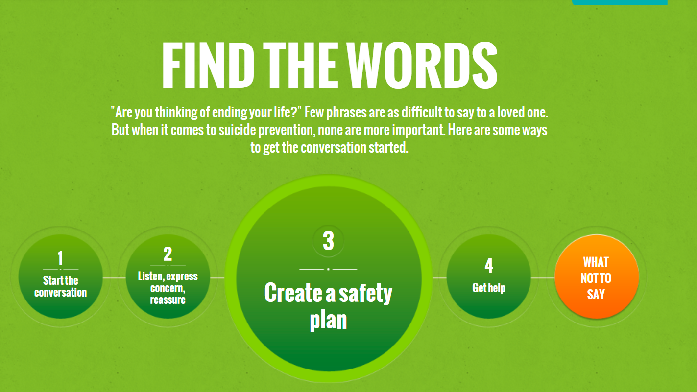
Notes:
Speaker’s Note: If you have time go live to Know the Signs website.
On the Find the Words portion of the website visitors can find a step-by-step approach to have this difficult conversation with someone they are concerned about, including tips on what to say, what not to say and creating a safety plan.

Slide 31
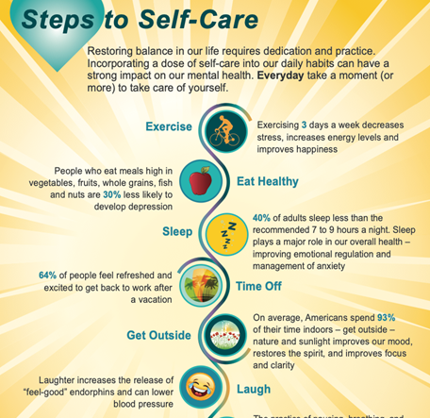
It’s Important to
Take Care of Yourself
Exercise
Healthy eating
Sleep
Time off
Get outside
Laugh
Practice mindfulness
Talk with a friend
K n o w t h e S i g n s >> F i n d t h e W o r d s >> R e a c h O u t >> www.SuicideIsPreventable.org
Notes:
Whether you are worried about someone and preparing to have the conversation, or just had the conversation, don’t forget self care. Make sure you have supports in place to help you deal with your feelings and anxieties.
Practice self care, especially around stressful situations such as these. Using the old oxygen mask analogy, you can’t effectively help others when you aren’t well yourself.
These are some tips for building self care into your daily routine. They may seem simple, but a growing field of study that looks at the basis of happiness is demonstrating that they can be powerful:
Exercise: Exercising 3 days a week (or more!) has been shown to decrease feelings of stress, increase energy levels, and improve overall feelings of happiness.
Healthy eating: Eating healthy doesn’t have to mean a rehaul of your diet or committing to the latest diet fad; small changes can make a big difference. People who eat meals high in vegetables, fruits, whole grains, fish and nuts are 30% less likely to develop depression.
Sleep: 40% of adults sleep less than the recommended 7 to 9 hours a night. Sleep plays a major role in our overall health – improving emotional regulation and management of anxiety.
Time off: Take time off whenever you can to do something you enjoy or just to change your routine. Even a small amount of time taken our of your day can help. 64% of people feel refreshed and excited to get back to work after a vacation.
Get outdoors: On average, Americans spend 93% of their time indoors – get outside – nature and sunlight improves our mood, restores the spirit, and improves focus and clarity.
Laugh: Laughter increases the release of “feel-good” endorphins and can lower blood pressure. Watch a movie or video that will make you laugh.
Practice Mindfulness: The practice of pausing, breathing, and just “being” is essential to our well-being and mental health, helping us reduce stress, worry less and enhance feelings of resiliency. Practicing mindfulness is all about simplicity, and you don’t need special training or skills. There are many free apps and videos that offer guided meditation. Many yoga classes are centered on mindfulness, incorporating breathing and movement to enhance mind-body balance.
Talk with a friend: Close social relationships improve our self-confidence and help us cope with ups and downs in life. Talk a walk with a friend or give one a call just to talk.
Download and share the tip sheet shown here, available in all threshold languages at https://emmresourcecenter.org/collection/covid-19-response

Slide 32

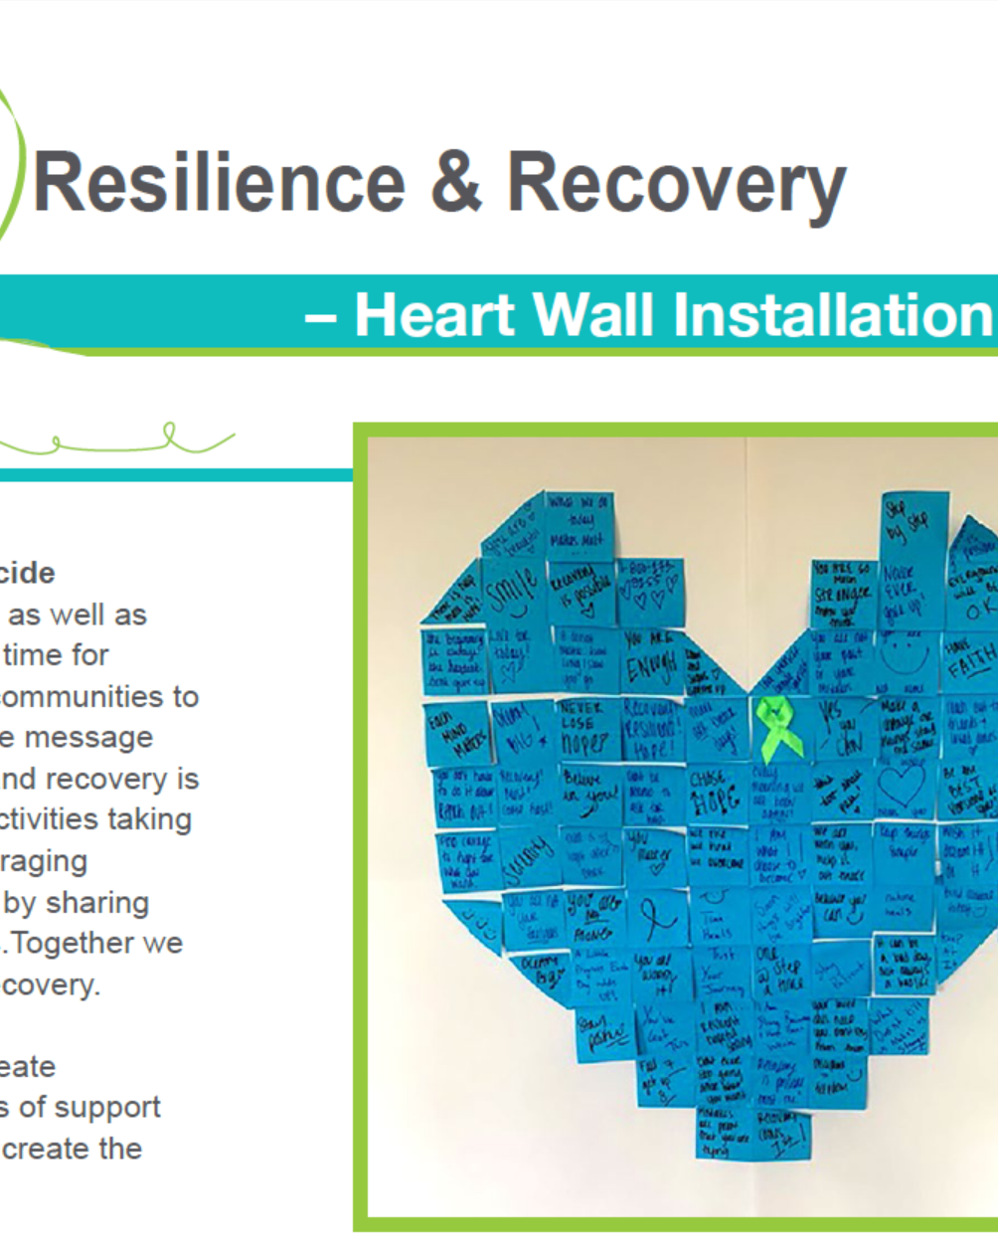

For Parents and Caregivers
K n o w t h e S i g n s >> F i n d t h e W o r d s >> R e a c h O u t >> www.SuicideIsPreventable.org
Notes:
In this section we will talk specifically to parents and caregivers.

Slide 33
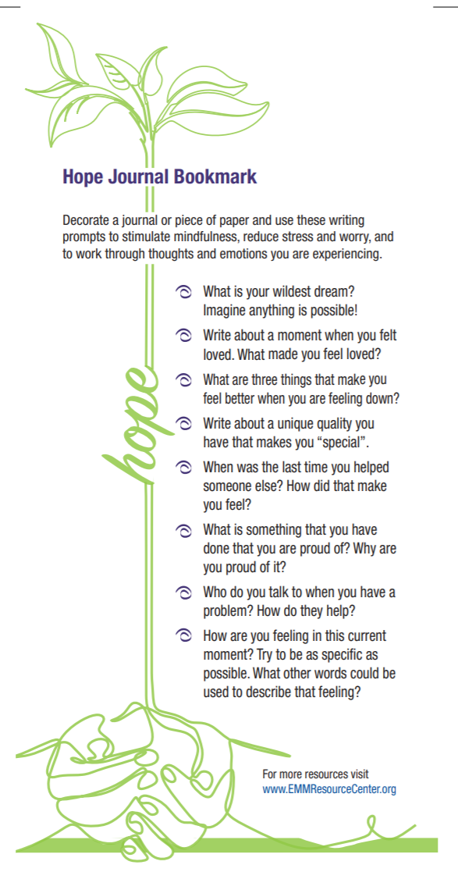

Raising Resilient Kids
Foster Positive Connections
  Encourage your child to have and maintain connections with friends and loved ones.
Promote Healthy Emotional Skills
  Help your youth cope with emotions such as stress, anger and sadness.
Encourage Basic Health Actions
  Physical exercise can help to reduce stress and depression.
  Eating healthy and getting a good amount of sleep can help the body to regulate.
Each Mind Matters Social Emotional Learning Resources can be found here: https://emmresourcecenter.org/children-and-suicide-prevention
K n o w t h e S i g n s >> F i n d t h e W o r d s >> R e a c h O u t >> www.SuicideIsPreventable.org
Notes:
Whether or not you have specific concerns about your child’s suicide risk, there are things you can do as a parent to build protective factors that can help youth cope with stressful events and emotional pain.
foster positive connections: Encourage your child to have and maintain connections with friends and loved ones, and to participate in activities that they enjoy. If they refuse to socialize, don’t force them. Spend extra time with them; even watching a movie together signals that you are there for them. It’s also great for a child to have additional adult mentors besides their parents. Talk to your child about who their reliable adults are, and who else can they speak to?
Promote healthy emotional skills: As much as we would like to protect our child from them, stressful situations and problems are part of life. Helping your youth cope with emotions such as stress, anger, and sadness can build their resiliency when problems occur.
Encourage exercise: Physical exercise produces changes in the body that can help reduce stress and depression. Activities such as yoga and mindfulness can be especially helpful for anxious and distracted youth.
Each Mind Matters Social Emotional Learning Resources can be found at: https://emmresourcecenter.org/children-and-suicide-prevention

Slide 34
Pain Isn’t Always Obvious: When to Worry
Mood changes can be part of the youth experience
It is important to stay vigilant for warning signs that your child is more than moody
Due to current events, our communities are impacted by additional mental health stressors and challenges
K n o w t h e S i g n s >> F i n d t h e W o r d s >> R e a c h O u t >> www.SuicideIsPreventable.org
Notes:
As any parent of adolescents or teens knowns, mood changes can be part of the youth experience. Stay vigillant for warning signs that your child is more than moody, such as significant changes in behavior or persistent changes in mood.
Like most of us, youth are likely to be undergoing additional stress and challenges in these difficult and uncertain times, so it’s also important to keep in mind that some changes are normal responses to current events.

Slide 35
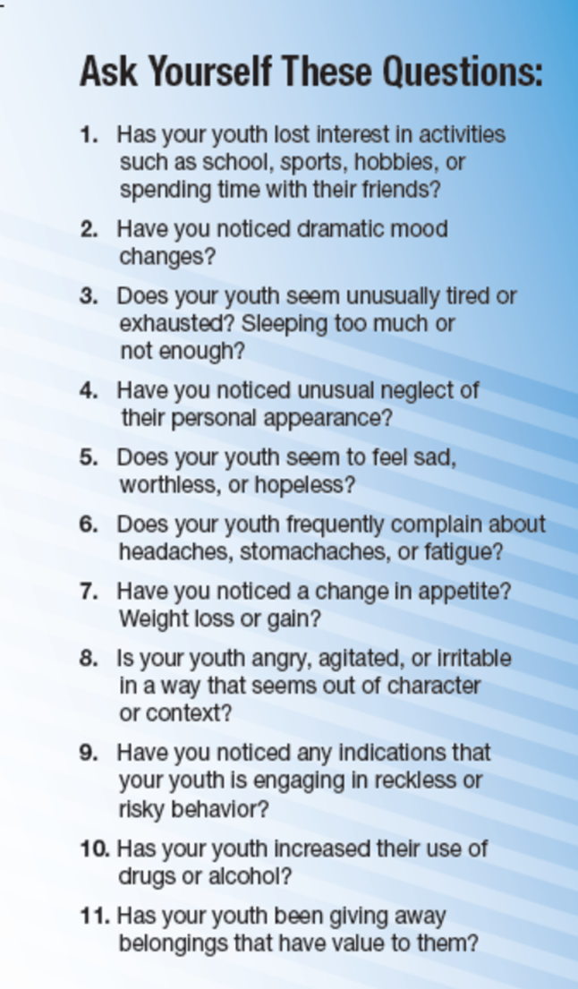
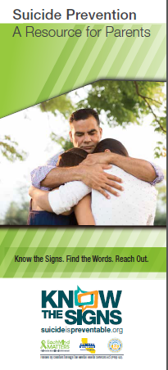
Ask Yourself These Questions
Has your child lost interest in things?
Are they having dramatic mood changes or changes in behavior?
Have you noticed them getting more angry, agitated or irritable?
Are they engaging in risky behavior?
Have they given away belongings?
K n o w t h e S i g n s >> F i n d t h e W o r d s >> R e a c h O u t >> www.SuicideIsPreventable.org
Notes:
Here are some questions you will want to ask yourself if you are worried that your child may be thinking about suicide. What we are looking for is changes in behaviors, especially ones that we discussed earlier when talking about warning signs, especially when they are related to a recent life stressor, loss or change.
The Suicide Prevention: A Resource for Parents Brochure can be found at: https://emmresourcecenter.org/resources/suicide-prevention-brochure-parents

Slide 36
Consider the Next Steps
A youth who is having thoughts about suicide, especially if they have a plan, needs to be evaluated by a mental health professional with training in suicide prevention.
Next steps include calling the National Suicide Prevention Lifeline, a local crisis center, a mental health professional, or your family doctor as soon as possible.
Your child’s school can also provide a variety of supports and help keep your child safe, so you are encouraged to engage the school.
K n o w t h e S i g n s >> F i n d t h e W o r d s >> R e a c h O u t >> www.SuicideIsPreventable.org
Notes:
Crisis lines are useful resources that can help you decide on next steps. Many additional resources are available through schools, and you can also talk to your child's physician about your concerns.

Slide 37
Additional Youth Resources
The Directing Change Program is an evaluated youth suicide prevention program with films by youth for youth.
Share program information with youth
Download hundreds of youth-produce PSAs for free
View SP 101 Prezi for youth
View educational videos on how to help a friend
www.DirectingChange.org
K n o w t h e S i g n s >> F i n d t h e W o r d s >> R e a c h O u t >> www.SuicideIsPreventable.org
Notes:
Speaker’s Note: if time permits, play the film (embedded in graphic in separate slide. Download films at: www.directingchange.org

Slide 38
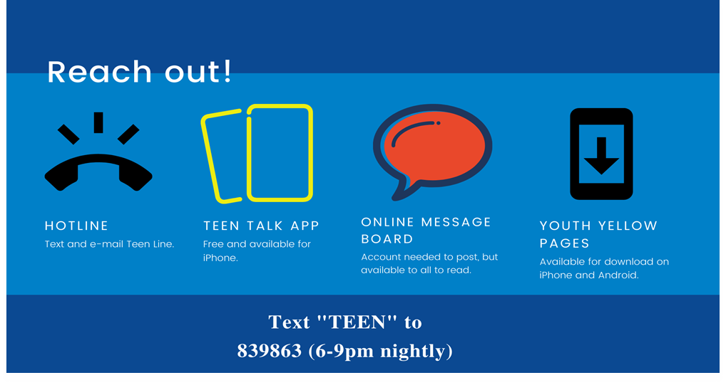

Teen Line:
Teens helping teens
Call 310.855.4673
or
text “TEEN” to 839863
Additional Resources For Youth
and Young Adults
The Trevor Project for LGBTQ youth (24/7)
Call 1.866.488.7386 or text START to 678678
K n o w t h e S i g n s >> F i n d t h e W o r d s >> R e a c h O u t >> www.SuicideIsPreventable.org
Notes:
In addition to the National Suicide Prevention Lifeline and Crisis Text Line, here are a few additional resources available to youth.
Teenline is a hotline staffed by youth. The youth answering calls have received training and are also supervised by a mental health professional.
Although Teenline is equipped to respond to crisis calls, many of the calls they receive are on a variety of topics including relationship issues, stress and anxiety.
Teenline is nationwide and available everyday from 6-9pm PST
The Trevor Project’s Trevor Lifeline is a 24/7 crisis resource for LGBTQ youth and young adults. They offer distress and crisis support via phone call, text or through Trevor Chat

Slide 39
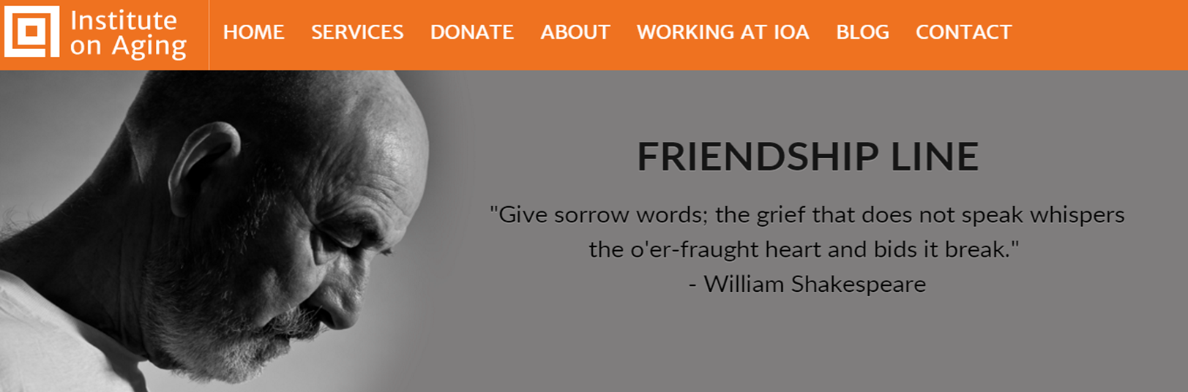
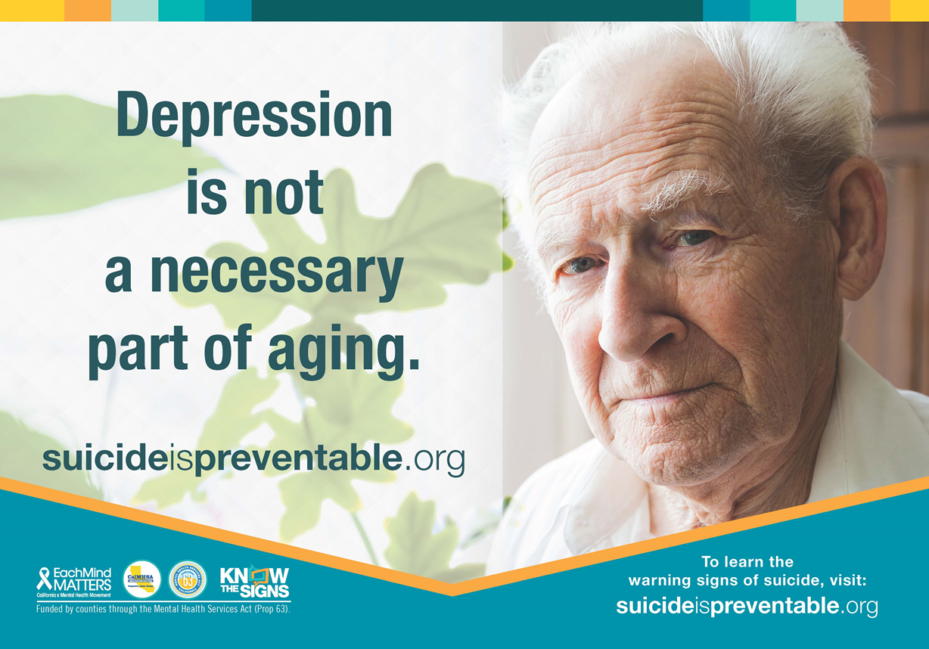
Older Adults & Caregivers
K n o w t h e S i g n s >> F i n d t h e W o r d s >> R e a c h O u t >> www.SuicideIsPreventable.org
Notes:
Health problems, isolation and diminishing feelings of connection and purpose can put older adults at risk of depression, and even suicide. During the pandemic, many older adults are even more isolated than before.
But depression is NOT a necessary part of aging. It is vital to connect with the older adults in your life, offer to listen, and be there for them in any way you can, whether it’s phone calls, porch visits, emails, or letters.
If you are concerned about an older adult in your life, or you work with older adults, download and share the brochure seen here from https://emmresourcecenter.org. The Friendship Line offers 24/7 crisis services for older adults via phone by calling 1-800-971-0016.

Slide 40
Test Your Suicide Prevention Knowledge
What are the three critical warning signs of suicide?
True or false: You should never ask someone if they are thinking about suicide.
What are three ways to help someone who is having thoughts of suicide?
Name at least two suicide prevention resources that are available 24/7.
K n o w t h e S i g n s >> F i n d t h e W o r d s >> R e a c h O u t >> www.SuicideIsPreventable.org
Notes:
Here are the 4 questions you saw at the beginning of the presentation. Have a look at your notes and compare your responses now.

Slide 41



K n o w t h e S i g n s >> F i n d t h e W o r d s >> R e a c h O u t >> www.SuicideIsPreventable.org
Notes:
You can also join Each Mind Matters: California’s Mental Health Movement which serves as the megaphone to highlight all of our collective efforts to promote mental health, end stigma related to mental illness and prevent suicide. Each Mind Matters is part of statewide efforts that are funded by counties through the Mental Health Services Act and administered by the California Mental Health Services Authority.
On the Each Mind Matters web site you can view videos of real people telling their stories that offer reasons to hope and access information about mental health designed for the general public.
Eachmindmatters.org
SanaMente.org

Slide 42

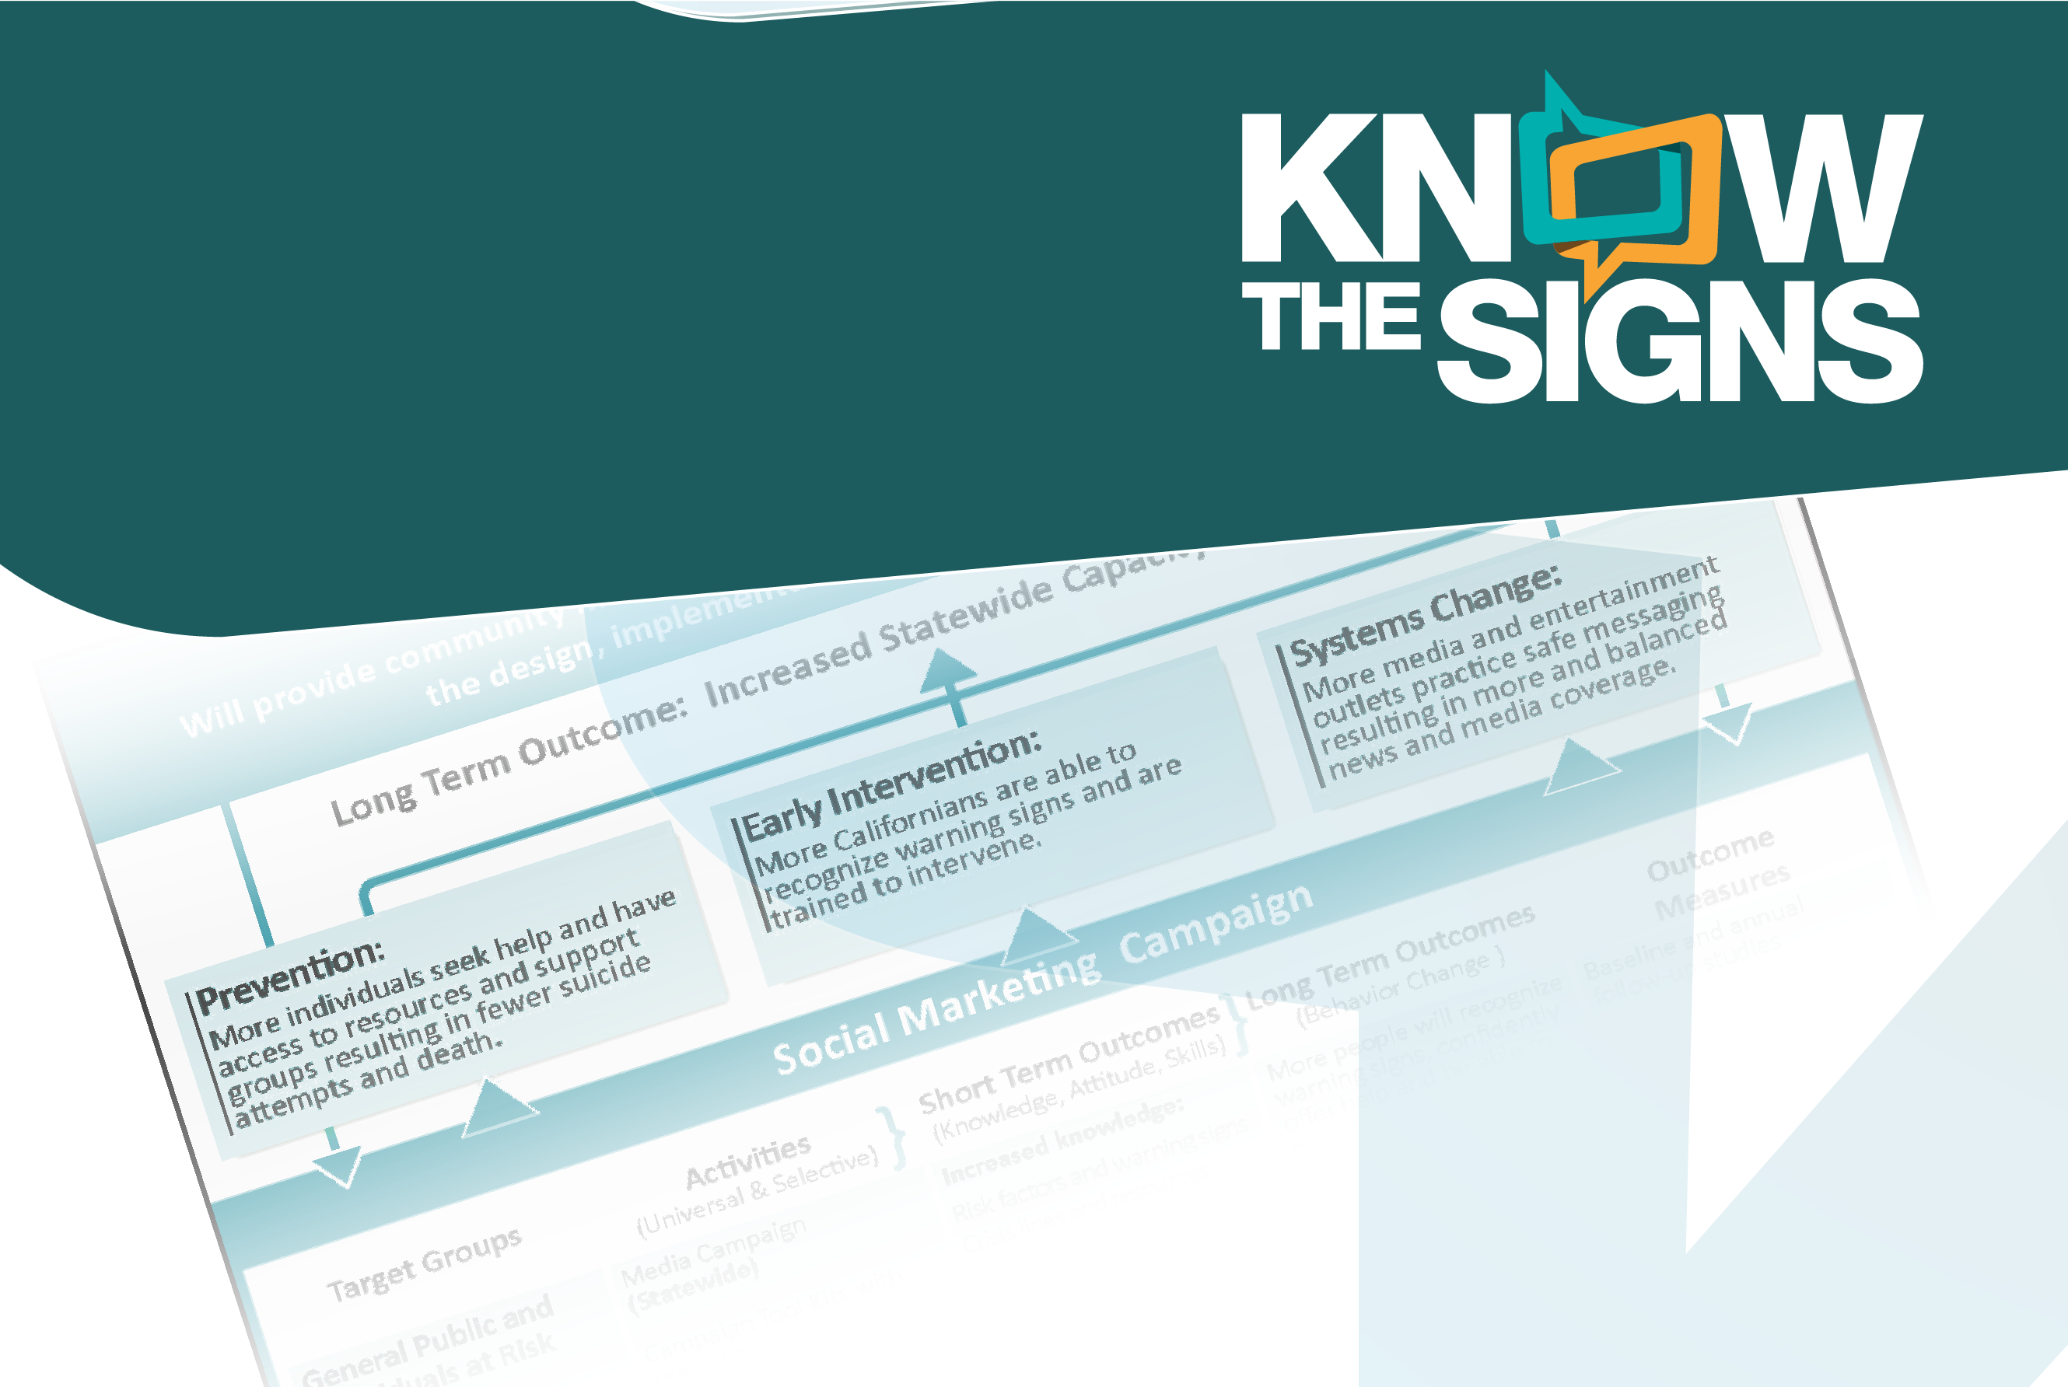
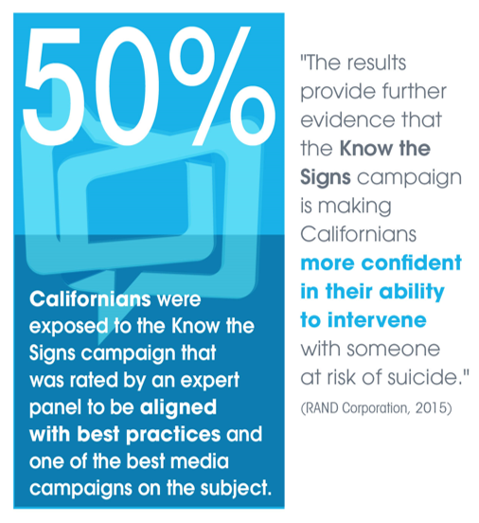
Know the Signs is a statewide suicide prevention social marketing campaign with the overarching goal to increase Californians’ capacity to prevent suicide by encouraging individuals to know the signs, find the words to talk to someone they are concerned
about, and to reach out to resources.
.
SuicideIsPreventable.org (public) ElSuicidioEsPrevenible.org (public)
EMMResourceCenter.org (Resources)
K n o w t h e S i g n s >> F i n d t h e W o r d s >> R e a c h O u t >> www.SuicideIsPreventable.org
Notes:
The overall goal of the Know the Signs campaign is to prepare more Californians to prevent suicide by encouraging them to know the warning signs, find the words to reach out to someone in crisis and reach out to local resources. There are two websites, one in English and one in Spanish, that provide the general public with information on warning signs and tips to ask directly about the suicide. The EMM Resource Center (https://emmresourcecenter.org) has downloadable outreach, media and training materials in many different languages.

Slide 43
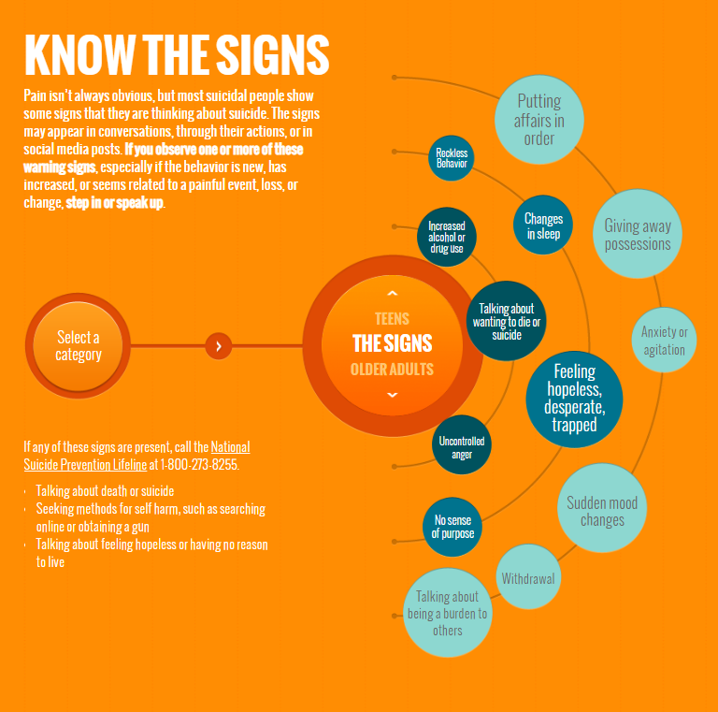
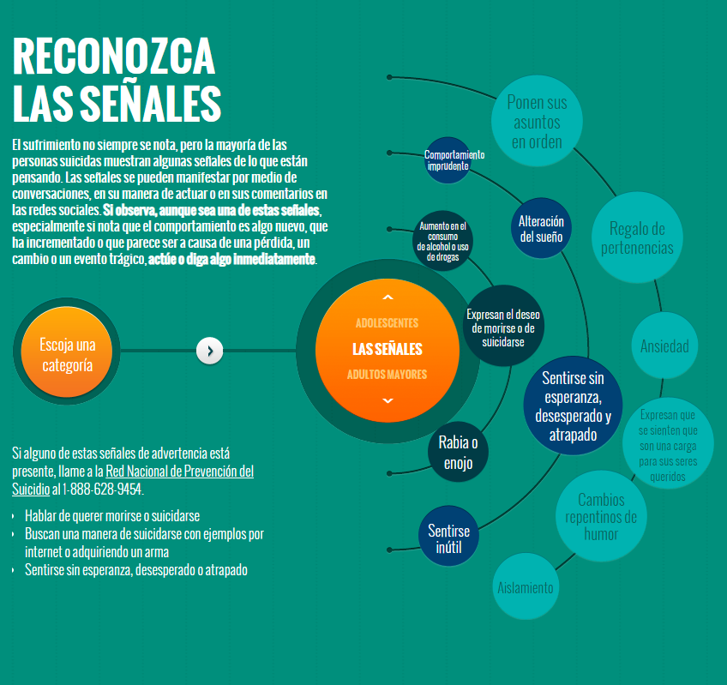
SuicideIsPreventable.org
ElSuicidioEsPrevenible.org
K n o w t h e S i g n s >> F i n d t h e W o r d s >> R e a c h O u t >> www.SuicideIsPreventable.org
Notes:
This slide shows the Know the Signs and Reconozca Las Senales web sites. Each offer a wealth of information similar to what we have talked about in this presentation, such as warning signs, how to have the conversation with someone you’re concerned about, and resources at the state and county levels.

Slide 44
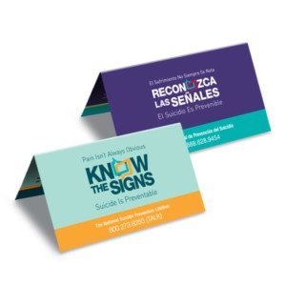
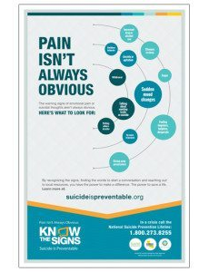

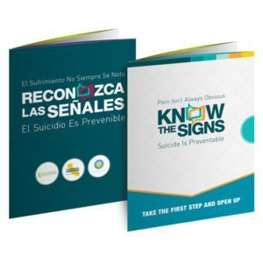
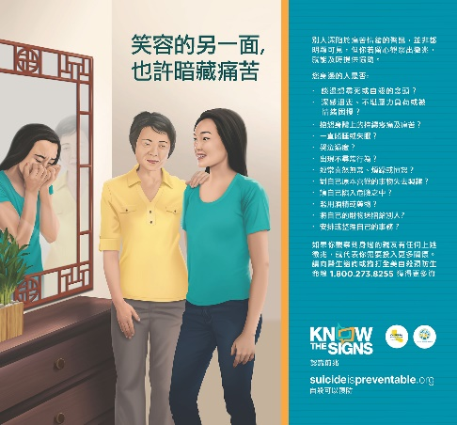
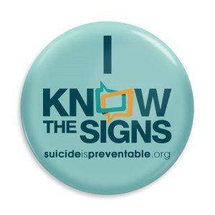
Suicide Prevention Resources
A wide range of mental health and suicide prevention educational resources are available for diverse communities across the lifespan:
African American
API youth
Cambodian
Chinese
Filipino
General public
Hmong
Individuals in crisis
Korean
Lao
LGBTQ youth and young adults
Middle aged men
Spanish-speaking
Vietnamese
Russian
Punjabi
EMMResourceCenter.org
Notes:
A range of Suicide Prevention materials can be viewed and downloaded on the Each Mind Matters Resource Center. The majority of materials are aimed at the helper, the person who can recognize warning signs and offer support, not the person at risk.
On the screen you can see a list of different cultural groups for which culturally and linguistically adapted materials are available. The URL to access these is https://emmresourcecenter.org

Slide 45
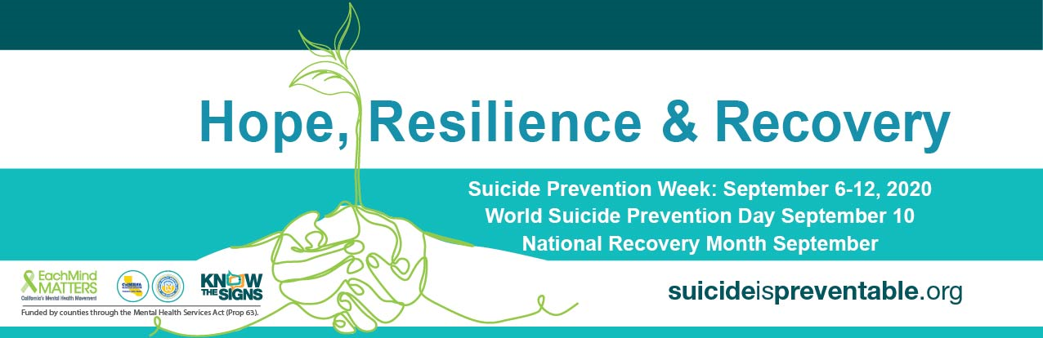
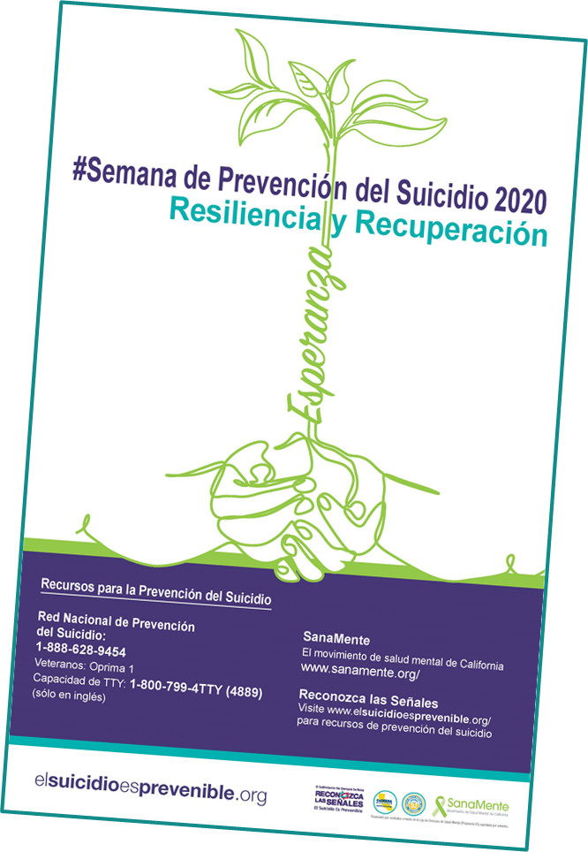

Suicide Prevention Activation Kit 2020-2021
The Online Activation Kit Includes resources that can be used year-round:
Virtual Activity Guide
Social Media Posts (English and Spanish)
Drop-in Articles (English and Spanish)
Social Emotional Learning Resources
Suicide Prevention and Substance Use Resources
Links to Helpful Resources & Messaging
Links to Know the Signs resources
Links to COVID-19 mental health resources
www.eachmindmatters.org/SPW2020/
K n o w t h e S i g n s >> F i n d t h e W o r d s >> R e a c h O u t >> www.SuicideIsPreventable.org
Notes:
Suicide Prevention Week happens each September, and this slide shows an example of the Activation Kit that was created in 2020 to support local events, education, and outreach around suicide prevention. The Activation Kit can be found at https://emmresourcecenter.org.

Slide 46
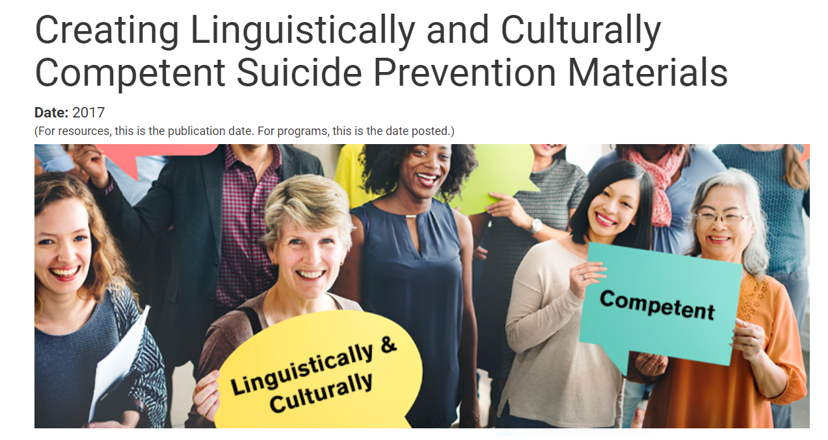
https://www.sprc.org/resources-programs/creating-linguistically-culturally-competent-suicide-prevention-materials
Notes:
The Suicide Prevention Resource Center also has information about creating culturally and linguistically competent suicide prevention materials.

Slide 47

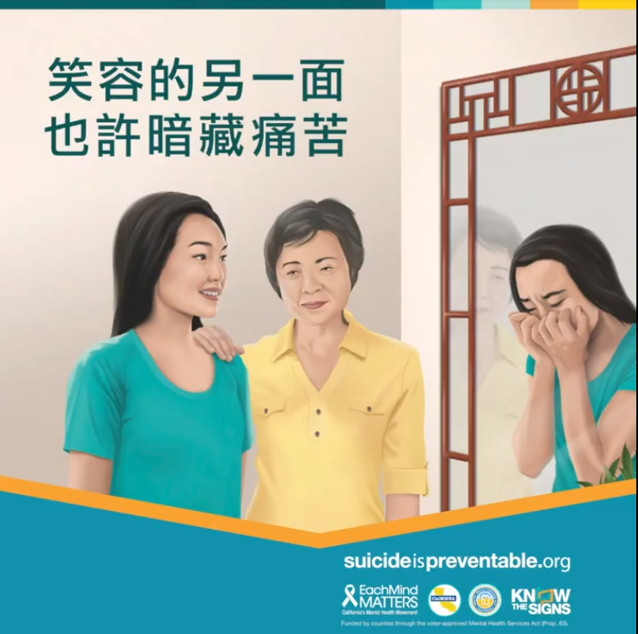
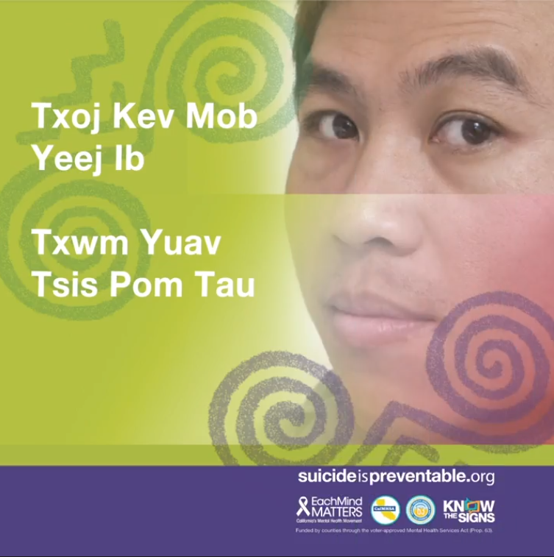

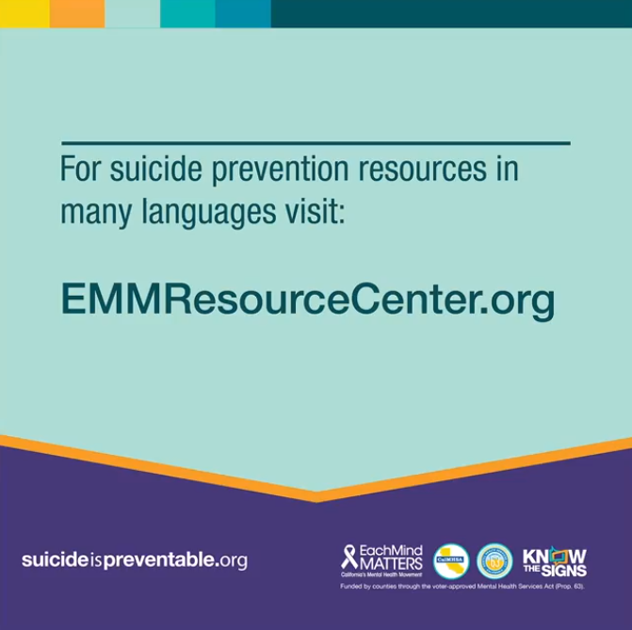

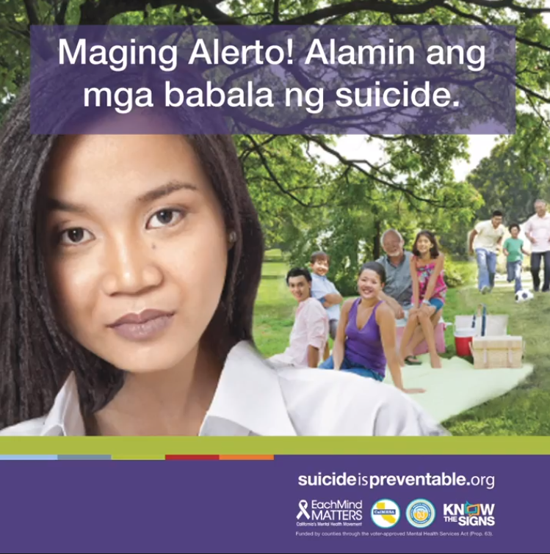
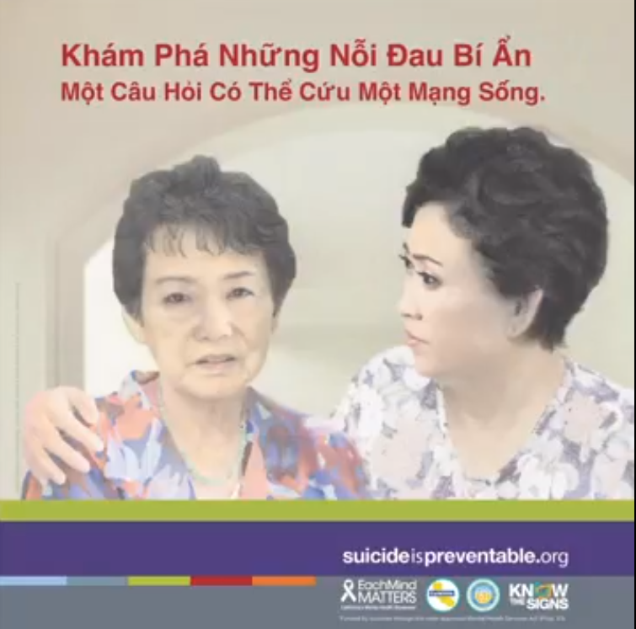
Cultural Resources Animation
Notes:
Finally, suicide prevention resources are available in many different languages on the Each Mind Matters Resource Center (https://emmresourcecenter.org). On screen are a few examples.
Speaker’s Note: You can replace these with your own resources. The images on the slide are hyperlinked and will play an animation if time permits.

Slide 48
Local Resources and Events
Insert information about local events and resources here.
Notes:
Speaker’s Note: Add your own resources and events on this slide.

Slide 49
Q&A
K n o w t h e S i g n s >> F i n d t h e W o r d s >> R e a c h O u t >> www.SuicideIsPreventable.org
Notes:
Speaker’s Note: open the session for questions.

Slide 50
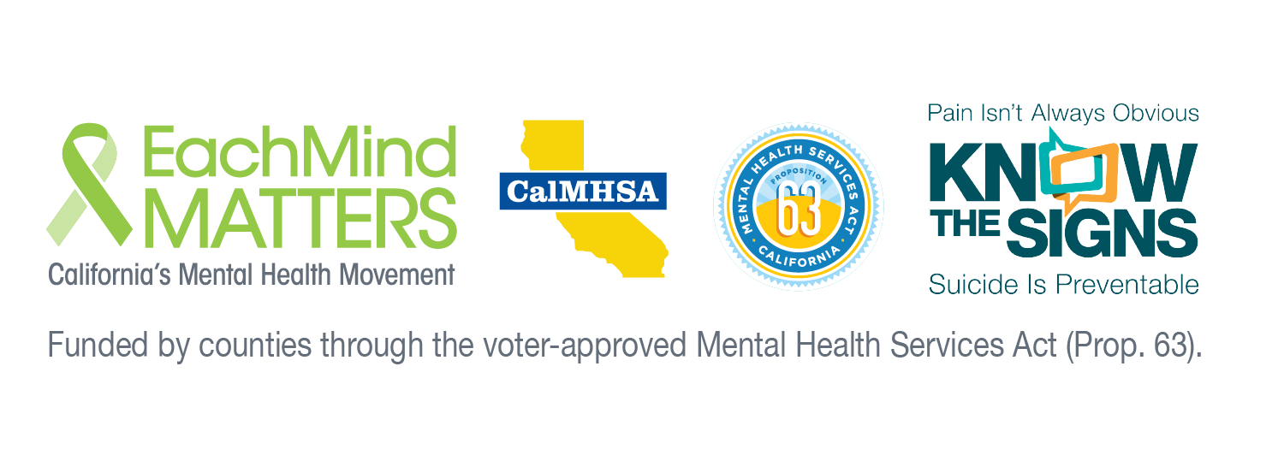
Thank you!
Insert presenter info here
K n o w t h e S i g n s >> F i n d t h e W o r d s >> R e a c h O u t >> www.SuicideIsPreventable.org
Notes:
Speaker’s Note: Insert your contact information here.

